Slide 1
TPS and ERP
Information Systems and Management

Slide 2
TRANSACTION PROCESSING
&
ENTERPRISE RESOURCE PLANNING
SYSTEMS
(TPS) & (ERP)

Slide 3
Transaction Processing Systems
(TPS)
Carry Out Routine Business Functions

Slide 4
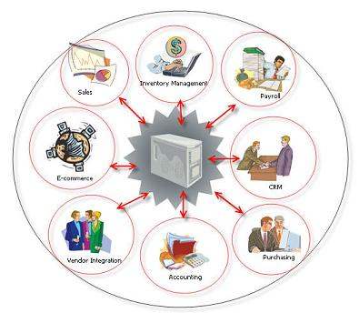
ERP
A collection of integrated cross-functional systems

Slide 5
OVERVIEW OF TPS
Batch Processing Systems
  Accumulate transactions for processing as a single batch or group of items
Online Transaction Processing (OLTP)
  Each transaction is processed immediately
Batch Vs. Online

Slide 6
CONTROL
&
MANAGEMENT ISSUES
Business Continuity Planning
  Identification of priorities for restoring business processes
  Specify action to be taken (and by whom) to restore operations

Slide 7
CONTROL
&
MANAGEMENT ISSUES
Transaction Processing System Audit
  Examine system to ensure:
    Data accuracy
    System integrity
  Audit Trail
    Documentation that allows the auditor to trace any system output back to the source

Slide 8

International Issues
Different language and culture
Disparities in information system infrastructure
  Quality of telecommunications
Varying Laws and Customs Rules
  Collection and dissemination of Data
Multiple Currencies

Slide 9
TPS and ERP
Information Systems and Management

